Slide 1


SUBJECT CODE
SUBJECT CODE
FINAL REVIEW
PROJECT ID: SEC2023CSPJ56
Name: SRINIDHI R - 412519104140
SRIVIDHYA S - 412519104143
C# AND .NET PROGRAMMING CS8073
TYPE THE SUBJECT NAME HERE
Earthquake prediction using Machine Learning
GUIDE NAME: Dr. J K Periasamy
Associate Professor / Department of CSE
IV
VII
CS8811
PROJECT WORK

Slide 2
CS8811
PROJECT WORK-FINAL REVIEW
PROBLEM STATEMENT
An earthquake does not exhibit any particular pattern, it is presumed as a spontaneous phenomenon that can damage huge number of lives and properties, and currently there is no any model exists that can accurately predict the exact position, magnitude, frequency and time of an earthquake.
The ability of Artificial Intelligence (AI)-based techniques to uncover buried patterns in data is well established. These models also result in an encouraging result when used to predict earthquakes.
A machine learning model capable of predicting earthquakes must be able to predict the accurate location, magnitude spectrum and precise occurrence time and chances of occurrence so that it allows authorities to deploy resources, and shutdown devices which will cause major damage.
So the prediction of earthquakes are highly beneficial and giving prior notifications to the people.

Slide 3
CS8811
PROJECT WORK-FINAL REVIEW
OBJECTIVE OF THE PROJECT
An approach for an event that is classified as negative or positive major earthquake by using Machine Learning algorithm based on magnitude,time etc.

Slide 4
CS8811
PROJECT WORK-FINAL REVIEW
An approach for prediction of earthquakes is presented. The goal of earthquake prediction is to give warning of potentially damaging earthquakes early enough to allow appropriate response to the disaster, enabling people to minimize loss of life and property. At present, the used models aren’t updated with latest datasets and have reduced accuracy. Prediction is done based on forecast, taking into consideration the history of earthquakes in specific countries and areas. In this context, the core idea is to predict whereas an event is classified as negative or positive major earthquake by applying machine learning algorithm. CatBoostRegressor algorithm,which is a member of the family of Gradient-boosted decision trees(GBDT) machine learning ensemble techniques outperforms Support Vector Machine (SVM). They are implemented and their efficiency is compared.
ABSTRACT

Slide 5
CS8811
PROJECT WORK-FINAL REVIEW
PROPOSED SOLUTION
The proposed model considers all the available public datasets in the recent days in order to build the system with the most updated, newest and relevant annotated data. The input parameter can be derived from a laboratory micro earthquake simulation.
Acoustic data input signal is used to predict the time remaining before the next laboratory earthquake. The training data is a single, continuous segment of experimental data. The test data consists of a folder containing many small segments. The data within each test file is continuous, but the test files do not represent a continuous segment of the experiment; thus, the predictions cannot be assumed to follow the same regular pattern seen in the training file.
For each seg id in the test data, a single time to failure is predicted corresponding to the time between the last row of the segment and the next laboratory earthquake.
CatBoost algorithm offers immense flexibility with its approach to handling heterogeneous, sparse, and categorical data while still supporting fast training time and already optimized hyperparameters.
The efficiency of CatBoost Regressor model is compared with SVM model and analysed using different metrics like F1 score and Mean Absolute Error (MAE).

Slide 6
CS8811
PROJECT WORK-FINAL REVIEW
REVIEW OF LITERATURE
SL NO | TITLE OF THE PAPER | TECHNOLOGY | JOURNAL NAME | YEAR
1. | Application of Artificial Intelligence in Predicting Earthquakes: State-of-the-Art and Future Challenges | AI,Deep Learning, Machine Learning | IEEE | 2021
2. | Disaster and Pandemic Management Using Machine Learning | Machine Learning, Disaster management | IEEE | 2020

Slide 7
CS8811
PROJECT WORK-FINAL REVIEW
SL NO | TITLE OF THE PAPER | TECHNOLOGY | JOURNAL NAME | YEAR
3. | DLEP: A Deep Learning Model for Earthquake Prediction | Earthquake prediction; Feature extraction; Explicit feature; Implicit feature; Deep learning method | IEEE | 2020
4. | Major earthquake event prediction using various machine learning algorithms | Machine learning, earthquake prediction | IEEE | 2019

Slide 8
CS8811
PROJECT WORK-FINAL REVIEW
SDG GOAL Number: 13
Climate Action
SAP GOAL Number: 13-SAP130103
Take urgent action to combat climate change and its impacts
The earthquake prediction system helps to give warning of potentially damaging earthquakes early enough to allow appropriate response to the disaster, enabling people to minimize loss of life and property.
We can feed AI systems information from seismic imaging to train them. The AI analyzes the data to learn about the patterns of various earthquakes and can then predict where an earthquake and aftershock might hit.
Thus it helps to take action to combat natural calamities by providing warnings and minimize loss.
JUSTIFICATION FOR SDG NO. AND SAP NO.

Slide 9
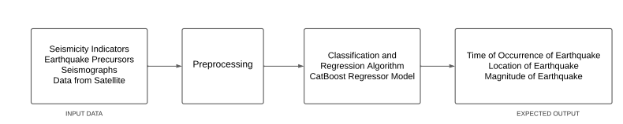
CS8811
PROJECT WORK-FINAL REVIEW
WORK FLOW DIAGRAM FOR EARTHQUAKE PREDICTION

Slide 10
CS8811
PROJECT WORK-FINAL REVIEW
DATA SET
Data fields
Each row contains following columns:
 | 9.dmin 10.rms 11.net 12.id 13.place 14.type 15. horizontalError 16.depthError | 17.magError 18.magNst 19.status 20.locationSource 21.magSource
1.time
2.latitude
3.longitude
4.depth
5.mag
6.magType
7.nst
8.gap

Slide 11
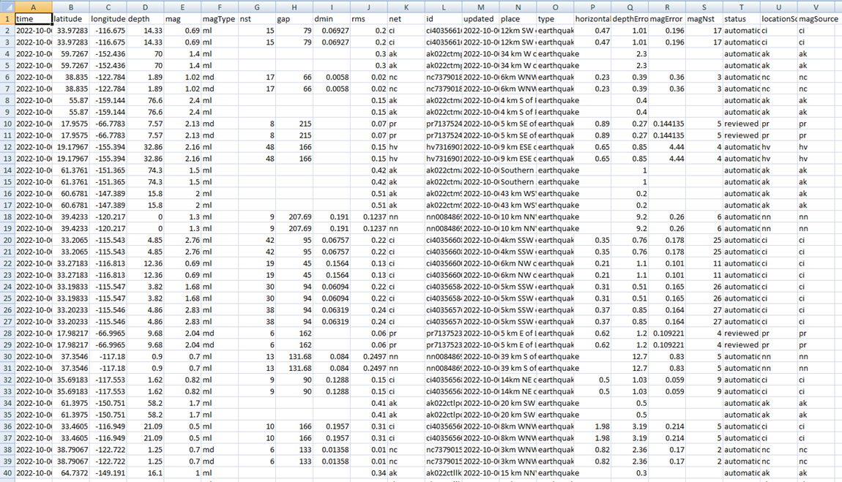
CS8811
PROJECT WORK-FINAL REVIEW
Data Set
WORK PROOF-PHOTO

Slide 12
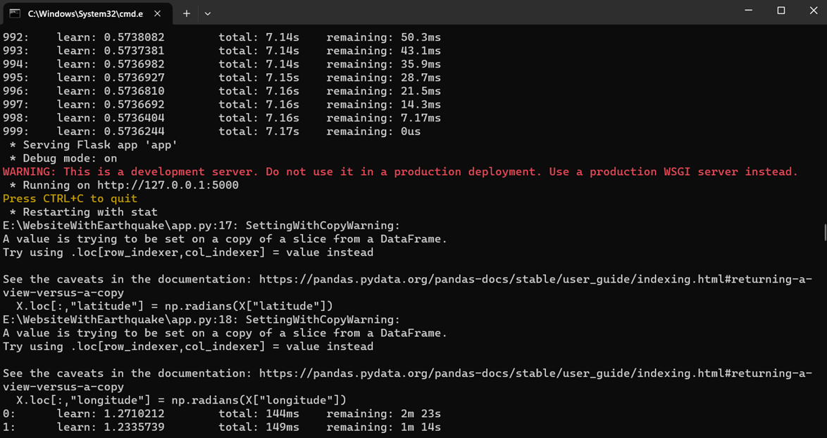
CS8811
PROJECT WORK-FINAL REVIEW
Starting Flask Server

Slide 13
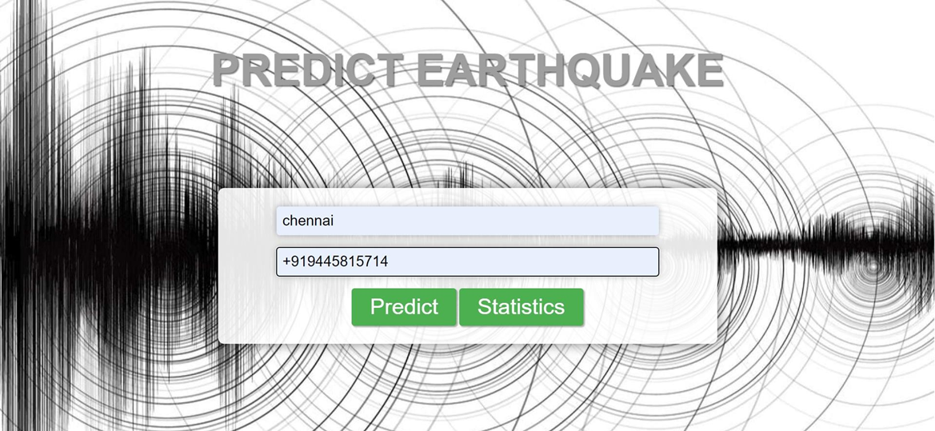
CS8811
PROJECT WORK-FIRST REVIEW
Home Page

Slide 14

CS8811
PROJECT WORK-FIRST REVIEW
Final Output

Slide 15
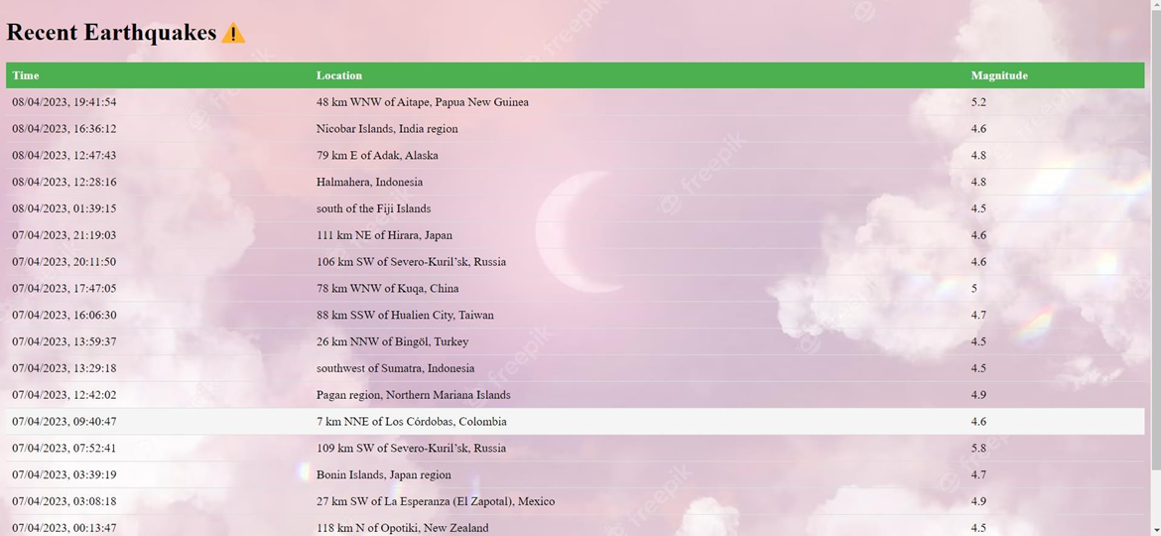
CS8811
PROJECT WORK-FIRST REVIEW
Statistics Feature

Slide 16

CS8811
PROJECT WORK-FIRST REVIEW
Automatic Sms Notification

Slide 17
CS8811
PROJECT WORK-FIRST REVIEW
Data Cleaning and Pre-Processing- The training data is a single, continuous segment of experimental data. The test data consists of a folder containing many small segments. For each seg id in the test folder, a single time to failure corresponding to the time between the last row of the segment and the next laboratory earthquake is to be predicted.
Feature Engineering and Model Implementation- The initial training set contains 4194 rows (one row for each segment) and 1496 columns (features). Genetic algorithm with Catboost Regressor is applied for fitness evaluation to implement a feature selection. Based on the GA's results, the model is trained using CatboostRegressor with default parameters.
Training a Model- The training dataset is used to train a Support vector machine and Radial basis function model.
Evaluating the Model-The model is evaluated based on the metrics like accuracy, precision, recall while testing the model with test data.
MODULE DESCRIPTION

Slide 18
CS8811
PROJECT WORK-FIRST REVIEW
SOFTWARE DETAILS:
Anaconda 4.11.0
Jupyter Notebook 6.4.5
SOFTWARE DETAILS

Slide 19
CS8811
PROJECT WORK-FIRST REVIEW
PROJECT MANAGEMENT-GANTT CHART
WORK | AUG’22 | SEP’22-NOV’22 | DEC’ 22-JAN’23 | FEB’23 | MAR’23
PROJECT APPROVAL
LIT REVIEW
DATA PRE- PROCESSING
MODEL IMPLEMENTATION
TRAINING A MODEL
EVALUATING THE MODEL

Slide 20
CS8811
PROJECT WORK-FIRST REVIEW
Most of the old approaches were limited due to lack of large volumes of annotated data for this specific task by the time their experiments were conducted.
Many of the existing prediction techniques provide high false alarm, therefore, lack of accurate prediction process is a contributor to this catastrophic consequence of earthquake. AI-based methods have created a new scope for improving this prediction process due to their high accuracy when compared to other techniques.
Many existing methods have been compared(Support Vector Machine) and method having highest efficiency has been implemented.
Genetic algorithm with CatboostRegressor has been applied and obtained highest efficiency.
Automatic SMS notification and statistics of all recent earthquakes
INNOVATION IN THE PROJECT

